Slide 1


ACELERAÇÃO DE OBRAS:
PERSPECTIVAS LEGAIS, TÉCNICAS E CONTRATUAIS

Slide 2

Aceleração de Obras: Prática Brasileira
Ana Clara Viola Ladeira,
Stocche Forbes Advogados

Slide 3
Contratos “Não Padronizados”
Cronograma de Recuperação
Ordem de Modificação – Ordem de Aceleração
Código Civil
Empreitada
Art. 607: “Se o empreiteiro não concluir a obra no prazo convencionado, responde por perdas e danos, salvo motivo de força maior.”
Art. 619: “O dono da obra pode introduzir modificações no projeto, desde que não alterem a natureza da empreitada, respondendo o empreiteiro pelos acréscimos ou diminuições de preço que resultarem das alterações.”
Art. 620: “Se as modificações ou acréscimos forem de tal monta que descaracterizem o projeto aprovado, o empreiteiro terá direito a rescindir o contrato, com a devida indenização.”
Alocação de Riscos (421-A), Reequilíbrio Econômico Financeiro (478 a 480), entre outros
Lei de Licitações e Contratos Administrativos
Art. 130: “Caso haja alteração unilateral do contrato que aumente ou diminua os encargos do contratado, a Administração deverá restabelecer, no mesmo termo aditivo, o equilíbrio econômico-financeiro inicial.”

Slide 4
Acceleration: Legal and Contractual Perspectives
Rebecca Shorter, Chair,
Society of Construction Law (UK)

Slide 5
Structure of Presentation
What is acceleration?
Types of acceleration
Standard forms
Industry guidance
Judicial guidance (UK)

Slide 6
What is acceleration?
Increasing the rate of progress to complete a project earlier
Three categories:
  Voluntary acceleration (can also be for mitigation purposes)
  Directed / Instructed acceleration
  Constructive acceleration

Slide 7
Constructive acceleration
There must be an excusable delay;
The delay must have been notified in a timely manner and a time-extension requested by the contractor;
The time extension request must have been delayed or refused by the employer/certifier;
The employer/certifier must have (expressly or implicitly) directed the contractor to complete within the original completion period, and;
The contractor must implement acceleration and incur costs.

Slide 8
Standard Forms
FIDIC
Each party required to use “all reasonable endeavours to minimise any delay in the performance of the contract”
No express mechanism to allow employer to instruct acceleration if the delay is not caused by the contractor
NEC 3 / 4
No express obligation to mitigate delay
PM may instruct Contractor to submit an acceleration quotation to achieve completion before “the Completion Date” / inform Contractor of revised date(s) (cl.36.1)
Contractor must provide a quotation and a revised programme showing how it can achieve the early completion date(s)
Contractor may decline to quote but, if it does, it must state why (cl 36.2)

Slide 9

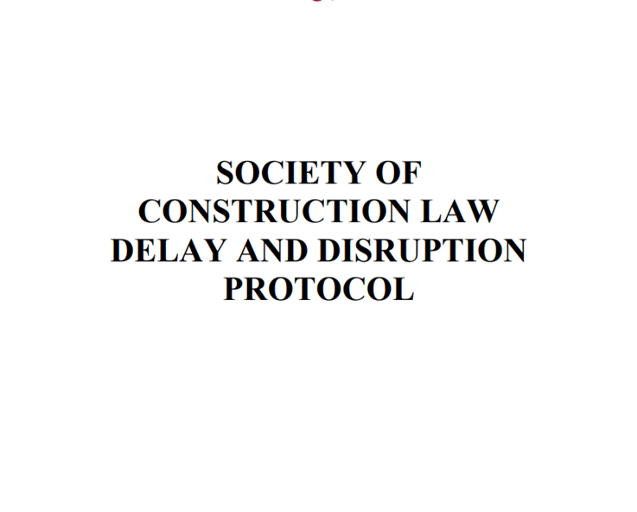
Industry Guidance: SCL Delay & Disruption Protocol (2nd Ed, 2017)
The Protocol provides guidance on some of the common delay and disruption issues that arise on construction projects
Protocol provides means by which the parties can resolve these matters and avoid disputes.
Practical and principled guidance on proportionate measures for dealing with delay and disruption
https://www.scl.org.uk/resources/delay-disruption-protocol

Slide 10
SCL Protocol (cont’d)
  “16.1 Some forms of contract provide for acceleration by instruction or by collateral agreement. In other forms, acceleration may be instructed by reference to hours of working and sequence. The Contractor cannot be instructed to accelerate to reduce Employer Delay, unless the contract allows for this.
  16.2 Where the contract provides for acceleration, payment for the acceleration should be based on the terms of the contract.
  16.3 Where the contract does not provide for acceleration but the Contractor and the Employer agree that accelerative measures should be undertaken, the basis of payment should be agreed before the acceleration is commenced.
  16.4 Where acceleration is instructed and/or agreed, the Contractor is not entitled to claim prolongation compensation for the period of Employer Delay avoided by the acceleration measures.

Slide 11
SCL Protocol (cont’d)
  16.5 Where the Contractor is considering implementing acceleration measures to avoid the risk of liquidated damages as a result of not receiving an EOT that it considers is due to it, and then pursuing a constructive acceleration claim, the Contractor should first take steps to have the dispute or difference about entitlement to EOT resolved in accordance with the contract dispute resolution provisions. Otherwise, there is the risk that it will not be entitled to compensation for those acceleration measures. In any event, before pursuing any such acceleration measures, the Contractor should provide notice with particulars of the intended acceleration measures to the CA. The Contractor should then include such measures in a revised programme.
  16.6 Just because the Contractor implements measures to recover Employer Delay does not necessarily mean that the full costs of those measures were caused by the Employer Delay. For example, the addition of a second labour gang may permit the relevant work activities to be completed in a shorter period of time but, overall, the Contractor may have incurred the costs of the same number of man-hours as it planned to do. Of course, the Contractor may incur higher rates in engaging the two labour gangs later in time because of the Employer Delay. Any such incremental costs therefore should be compared with prolongation costs that would otherwise have arisen to identify whether those incremental costs are reasonable. Further, any resulting crowding of labour may lead to loss of productivity which could then form the basis of a disruption claim.”

Slide 12
Judicial Guidance from the English Courts
A claim which suceeded:
Great Eastern Hotel Company v John Laing Construction Ltd [2005] EWHC 181 (TCC)
“Any acceleration measures even if partially successful, were clearly measures adopted in order to mitigate [the employer’s] losses and as such the cost of such measures are recoverable from the contract breaker”
A claim which failed:
Ascon Contracting Ltd v Alfred McAlpine Construction Isle of Man (1999) 66 Con LR 119
“…there cannot be both an extension to the full extent of the employer's culpable delay, with damages on that basis, and also damages in the form of expense incurred by way of mitigation, unless it is alleged and established that the attempt at mitigation, although reasonable, was wholly ineffective. …”

Slide 13
Judicial Guidance from the English Courts (cont’d)
  A claim which succeeded even though no time was made up
  Cleveland Bridge UK Ltd v Severfield-Rowen Structures Ltd [2012] EWHC 3652 (TCC)
  “… Although SRS instituted extensive accelerative measures in terms of night-time, weekend and extended hours working which, all things being equal, should have had the effect of recovering all or some of the 56 days delay, SRS in fact finished even later. … Not only was the acceleration in the result wholly unsuccessful, matters deteriorated. …”
  “It is often easy after an emergency has passed to criticise the steps which have been taken to meet it, but such criticism does not come well from those who themselves created the emergency. The law is satisfied if the party placed in a difficult situation by reason of the breach of a duty owed to him has acted reasonably in the adoption of remedial measures, and he will not be held disentitled to recover the costs of such measures merely because the party in breach can suggest that other measures less burdensome to him might have been taken.”

Slide 14
Thank you

Slide 15
Acceleration: Technical Perspectives
Vincent LEFEUVRE,
Diales

Slide 16
Structure of Presentation
What is project acceleration?
What is “excusability” ?
How to plan an acceleration?
  Accountability,
  Levers to accelerate work,
  Pitfalls to avoid.

Slide 17
What is project acceleration?
Acceleration is the execution of work at a faster rate than originally planned, often to recover delay or to meet a revised completion date.
Instructed by Owner Contractor is required to complete a contracted scope of work earlier than scheduled.
  A directed acceleration occurs when Owner formally directs such acceleration completion.
  A constructive acceleration generally occurs when :
    Contractor is entitled to an excusable delay;
    Contractor requests a time extension from the owner and owner declines to grant such time extension or grants one in an untimely manner;
    Owner either expressly orders completion within the original performance period or implies in a clear manner that timely completion within the original performance period is expected; and
    Contractor gives notice to Owner that Contractor considers this action an acceleration order.
Voluntary acceleration
  In contracting, mitigation refers to the affirmative obligation of each party to take action to decrease, lessen or minimize damages (time and money) to the other party.
AACE - 10S‐90: Cost Engineering Terminology and AACE RP 52R-06, Time Impact Analysis

Slide 18
What is “excusability” ?
Acitvity as done
Acitvity as planned
Owner’s delay
Contractor’s delay
Force majeure
[1] Delays that are excusable but not compensable for the Contractor:
[2] Delays that are excusable and compensable for the Contractor:
[3] Other delays are neither excusable nor compensable for the Contractor.
[1]
[2]
[3]
Owner may order a directed acceleration. Contractor may plan a constructive acceleration
Contractor may (must) mitigate delay

Slide 19
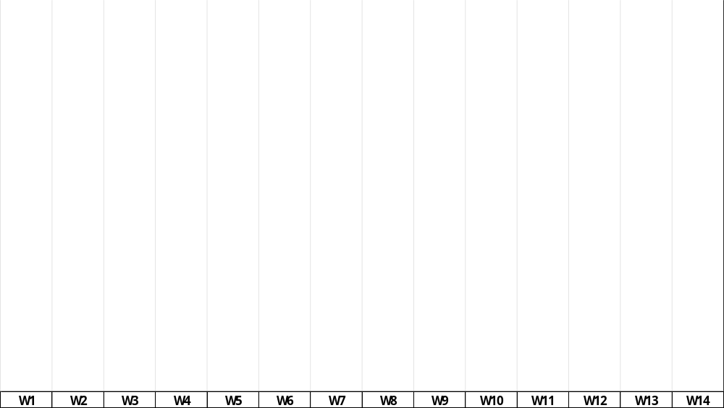
How to plan an acceleration
As-planned at Week 0
Futur
Carry out a retrospective delay analysis (TIA, …) to:
Determine the excusability of critical delays,
Determine the extent of critical and other delays.
[1] Contractor mobilisation on Site
[2] Vendor on Site
[3] Civil works
[4] Vendor in-house manufacturing of equipment parts
[5] Equipment erection on Site
[6] End
W0

Slide 20
How to plan an acceleration
At the end of Week 2
Past
Futur
Carry out a retrospective delay analysis (TIA, …) to:
Determine the excusability of critical delays,
Determine the extent of critical and other delays.
---
  Critical path → past & future part.
[4], [5] and [6] are critical.
Excusable two-week delay
Owner’s request of acceleration.
Acceleration plan only affects the future part.
[1] Contractor mobilisation on Site
[2] Vendor on Site
[3] Civil works
[4] Vendor in-house manufacturing of equipment parts
Employer delay
[5] Equipment erection on Site
[6] End
W0

Slide 21
How to plan an acceleration
At the end of Week 2
Past
Futur
Carry out the acceleration plan:
Overlapping different phases of the project instead of completing one phase before starting the next.
[1] Contractor mobilisation on Site
[2] Vendor on Site
[3] Civil works
[4] Vendor in-house manufacturing of equipment parts
Employer delay
[5] Equipment erection on Site
[6] End
W0

Slide 22


How to plan an acceleration
At the end of Week 2
Past
Futur
Carry out the acceleration plan:
Overlapping different phases of the project instead of completing one phase before starting the next.
Adding Resources
Working Overtime
Prefabrication and Modular Construction
Design Modifications
Enhanced Project Management
…
[1] Contractor mobilisation on Site
[2] Vendor on Site
[3] Civil works
[4] Vendor in-house manufacturing of equipment parts
Employer delay
[5] Equipment erection on Site
+
[6] End
W0

Slide 23
How to plan an acceleration
At the end of Week 6
Past
Futur
Pitfalls to avoid:
Parallel tasks that are not critical in week 2 should be monitored during the acceleration phase. They may become critical and completely negate the effects of acceleration.
Direct costs of early mobilising Vendors and Contractor’s erection resources.
Unnecessary stress and negative psychological impact on the teams
Storage costs for equipment parts delivered on site
…
[1] Contractor mobilisation on Site
[2] Vendor on Site
[3] Civil works
Unforeseeable delay
[4] Vendor in-house manufacturing of equipment parts
Employer delay
[5] Equipment erection on Site
+
[6] End
W0

Slide 24
Conclusion
A preliminary delay and causality analysis must establish responsibility for the delay to be recovered.
Assess Contractor's technical and financial capacity to accelerate the works. An acceleration involves changing the working methods that Contractor intended to implement at the start of the project.
  Acceleration comes at a cost and requires appropriate organisation.
  Acceleration generates additional risks that were not taken into account during the tender phase.
  Avoid acceleration plans that are too long or cover too large a part of the project.
The schedule supporting the acceleration plan must be complete and the tasks must be correctly linked.
  Simulate acceleration plans to identify pseudo-critical paths that may affect the benefits of the acceleration plan.
  Simulation can be performed using statistical tools (Primavera Risk Analysis).
Evaluate acceleration levers, starting with the simplest to implement and moving on to the most complex.
  Simple reorganisation of activities or on-site resources, overtime, --> global reorganisation and mobilisation of additional resources.
When calculating the financial cost of acceleration, consider the additional risks involved. For example:
  Productivity losses: 20 people in a confined space will not work twice as fast as 10 people in the same space.
  Possible deterioration in quality and therefore the need for rework.

Slide 25

Vincent Lefeuvre
Since 2025, Vincent LEFEUVRE, Technical Director, has been working in the Paris office of DIALES as an expert witness on international construction issues. With over 25 years' professional experience in international construction projects, he specialises in the management and prevention of disputes.
As a recognised expert in his field, Vincent is regularly called upon to testify independently about his work before arbitral or judicial tribunals and also to provide strategic support to his clients during amicable dispute resolution proceedings, always with a strong exposure to oral or written defence of his positions.
Over the years, he has acquired expertise in a wide range of construction sectors: rail (signalling, rolling stock and infrastructure), oil/gas, chemicals, energy, civil aviation, automotive and real estate assisting his clients in their strategic approach to defending their interests in various contexts. : Expertise and Expert Determination, Expert Testimony, Delicate Negotiations, Risk Analyses, Situation Audits of construction projects in the execution phase, on their Contractual, Time impacts, Quantum and Technical aspects.
He also participates in a number of think tanks and training programmes.
DIALES
Construction Delay Expert
Paris, France
+33 615 206 427
vincent.lefeuvre@diales.com

Slide 26
Aceleração de Obras: Pleitos
Paulo Lage Martins da Costa,
Hect

Slide 27
Claims envolvendo aceleração em obras
>50%
>70%
das disputas relacionadas à construção
do valor do
pedido das
contratadas
em grandes números
dados de 16 casos de disputas da construção

Slide 28
Claims envolvendo aceleração em obras são, frequentemente, objeto de .divergência. entre as partes na administração contratual e se tornam motivos de .disputas.
as partes em geral desconhecem os conceitos de aceleração dirigida, construtiva e voluntária
durante a gestão do Contrato, as partes tendem a divergir sobre a responsabilidade por atrasos
ausência de Cláusulas específicas sobre aceleração (principalmente construtiva)
falta de atualizações periódicas de cronograma que impedem a visualização de atrasos de forma contemporânea
dificuldade do contratado em evidenciar o nexo entre os custos reclamadas e os esforços de aceleração
prorrogações de prazo sem discussão sobre responsabilidade

Slide 29
a mecânica dos Claims por aceleração
Aceleração Dirigida
Aceleração Construtiva
os métodos estão intrinsecamente ligados aos tipos de aceleração
Aceleração Voluntária

Slide 30


os custos da aceleração dirigida são compensáveis ao contratado
...contudo, existe uma área .cinzenta. relativa à quantificação quando ela não é previamente acordada: o quanto é aceleração dirigida e o quanto seria voluntária?
dono da obra solicita uma Change Order para que o contratado acelere as obras
contratado apresenta plano de aceleração indicando o novo histograma e os custos adicionais
custos adicionais com aceleração são compensáveis

Slide 31





a aceleração construtiva é o tipo mais comum nas disputas
atraso justificável
contratado solicita extensão de prazo
dono da obra rejeita a solicitação
Análises de Cronograma devem ser empregadas para que se .evidencie. a aceleração
dono cobra a manutenção do prazo original
contratado notifica sobre aceleração

Slide 32

identificação da aceleração por meio de técnicas de análise de cronograma
CRONOGRAMA IMPACTADO
ATIVIDADE 1
ATIVIDADE 2
CRONOGRAMA AS-BUILT
ATIVIDADE 3
ATIVIDADE 4
CONCLUSÃO IMPACTADA
ATIVIDADE 1
ATIVIDADE 2
ACELERAÇÃO
ATIVIDADE 3
ATIVIDADE 4
CONCLUSÃO REAL

Slide 33




AUMENTO DOS
RECURSOS DIRETOS
danos decorrentes da aceleração
Mão de Obra Direta e equipamentos incrementais;
Adicional de Hora extra, turnos adicionais e trabalhos aos finais de semana; e
Custos para aceleração dos subcontratados.
Os esforços de aceleração geram custos adicionais ao empreiteiro, os quais devem ser correlacionados às atividades que foram aceleradas. Neste caso, podem ser demandadas análises de produtividade para complementar as análises
AUMENTO DOS
RECURSOS DIRETOS
Aumento das equipes de supervisão, logística, gestão etc.;
Custos com equipamentos de transporte; e
Despesas administrativas relacionadas aos esforços de aceleração.
PERDA DE PRODUTIVIDADE
decorrente do incremento de recursos, empilhamento de negócios, horas extras e fadiga dos colaboradores.

Slide 34

Claims referentes à aceleração: análise quantitativa dos recursos utilizados
Curva do
Histograma Previsto
Pico:
6 colaboradores
PROJETO DE CONSTRUÇÃO | PRAZO PREVISTO = 14 MESES
ATRASO - 6 MESES

Slide 35


Claims referentes à aceleração: análise quantitativa dos recursos utilizados
Curva do
Histograma Realizado
Pico:
11 colaboradores
PROJETO DE CONSTRUÇÃO | PRAZO PREVISTO = 14 MESES
DURAÇÃO REAL = 12 MESES
ATRASO - 6 MESES

Slide 36
Claims referentes à aceleração: análise quantitativa dos recursos utilizados
PROJETO DE CONSTRUÇÃO | PRAZO PREVISTO = 14 MESES
DURAÇÃO REAL = 12 MESES
ATRASO - 6 MESES

Slide 37

Claims referentes à aceleração: análise quantitativa dos recursos utilizados
efetivo impedido
PROJETO DE CONSTRUÇÃO | PRAZO PREVISTO = 14 MESES
DURAÇÃO REAL = 12 MESES
ATRASO - 6 MESES

Slide 38
Claims referentes à aceleração: análise quantitativa dos recursos utilizados
efetivo previsto no prazo previsto
PROJETO DE CONSTRUÇÃO | PRAZO PREVISTO = 14 MESES
DURAÇÃO REAL = 12 MESES
ATRASO - 6 MESES

Slide 39
Claims referentes à aceleração: análise quantitativa dos recursos utilizados
efetivo impedido transferido
PROJETO DE CONSTRUÇÃO | PRAZO PREVISTO = 14 MESES
DURAÇÃO REAL = 12 MESES
ATRASO - 6 MESES

Slide 40
Claims referentes à aceleração: análise quantitativa dos recursos utilizados
efetivo adicional
pela aceleração
PROJETO DE CONSTRUÇÃO | PRAZO PREVISTO = 14 MESES
DURAÇÃO REAL = 12 MESES
ATRASO - 6 MESES

Slide 41
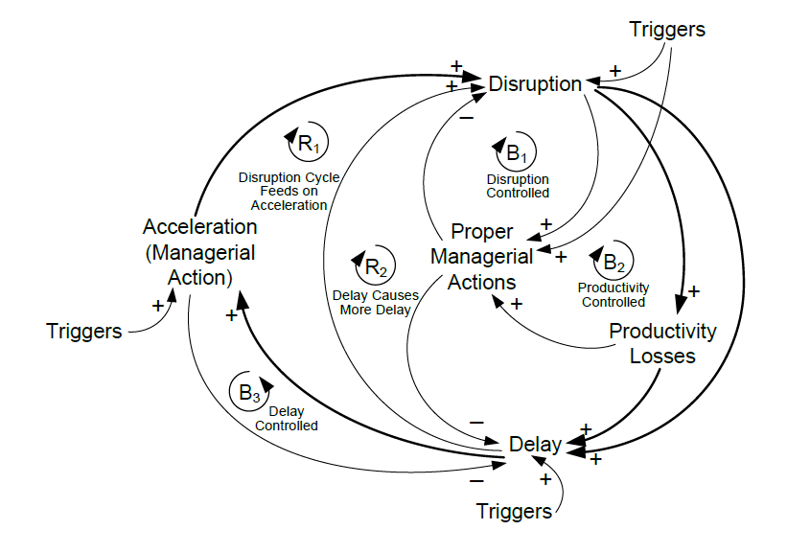
causa raiz
atraso
necessidade de
prorrogação de prazo
prorrogação de prazo não disponível
necessidade de aceleração
medidas de aceleração
AUMENTO DOS CUSTOS
DE PRODUTIVIDADE

Slide 42
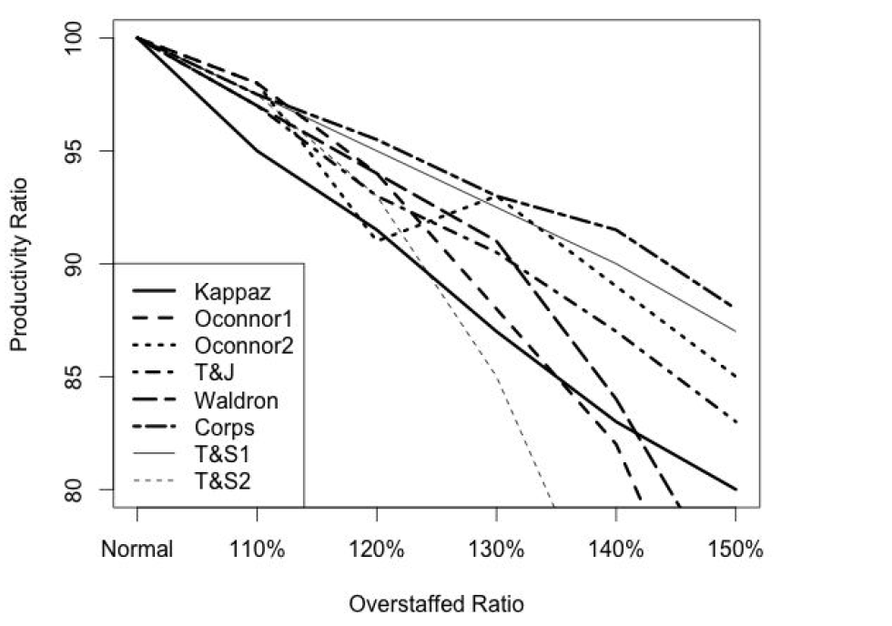
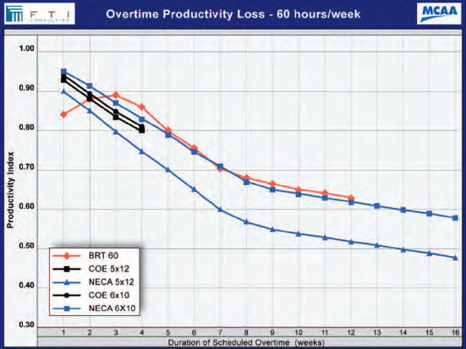
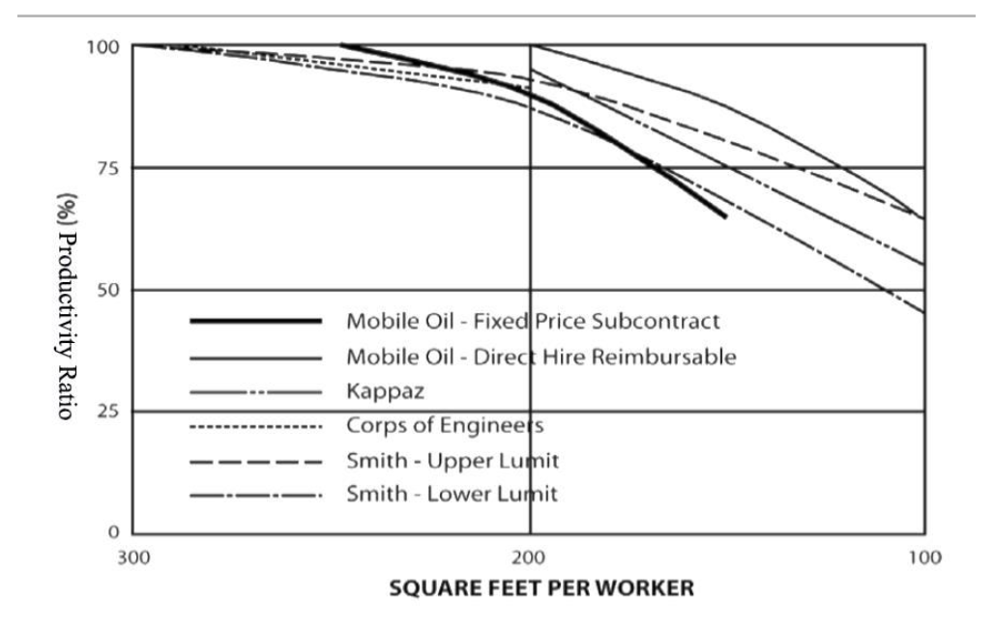

Slide 43
Obrigado!

Slide 44


