Slide 1

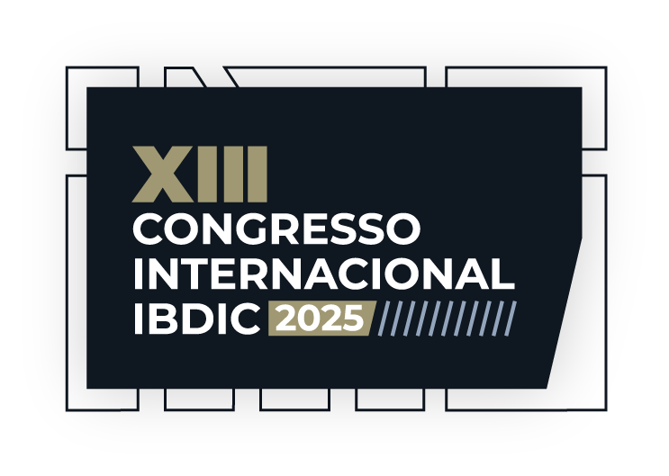

The Essential Innovations in Construction
Ed Merrow
Executive Chairman
Independent Project Analysis, Inc. (IPA)

Slide 2

We Need New Thinking
Upstream and downstream, off-shore and on-shore, the petroleum industry construction is at a very uniquely difficult juncture
  Low oil prices
  Consolidating supply chains
  Risk-averse contractors
  Weakening project resources within owners
We need innovation today far more than at any other point in our history
Productivity improvements in industrial construction have been significantly slower than in other sectors such as manufacturing and agriculture
It is said that we are unwilling to take up new technology, but that is clearly wrong: 30 years ago there were no floating platforms and no deepwater subseas
But many who complain about low productivity growth in construction don’t know the first principles of economics: large improvements in productivity require massive substitution of capital for labor
This is the core problem with regard to productivity in construction

Slide 3
Our Challenges
Our biggest challenges today are:
Highly consolidated supply chains that give substantial pricing power to providers; this is driven in part by the peculiar dynamics of an industry being slowly forced out of existence; it has happened in other dying industries as well, but it has never happened to an industry that was otherwise vibrant
Engineering costs, a labor input, will be increasing as the supply of engineers is insufficient to get work done
Construction is a young person’s occupation and the demographic profile is unfavorable especially in key nations for our supply chains—a birth rate of 2.1 is needed just to stay even:
    Japan 1.2 A premier maker of equipment
    China 1.0 The key maker of almost everything
    Korea .78 World’s best fabrication yards (with the lowest birthrate in the world!)
Unless we can find a way to dramatically decrease the labor inputs in our projects, we will be stuck with poor productivity in a world that is increasingly short of labor
Are there technological solutions to this problem?

Slide 4
Will Technology Save Us?
There have been numerous incremental technologies that have made construction more efficient, such as drones to do inspection, advanced photogrammetry to assist with as-built drawing for brownfield projects, etc.
Digitalization is more likely to improve operating costs rather than construction because digital twins combined with automation may allow on-shore operation of complex off-shore operations
Thus far, design automation has been a major disappointment as the number of hours required to render a given design has not improved very much and quality remains a problem
Generative AI may do some wonderful things for us, e.g., capturing learnings from projects, accelerating design, but it is not realistic to believe that AI can fundamentally change the construction side of the equation—it does not remove enough hours

Slide 5
The Solutions are Known but not Easy
Standardization at every level
  Standardization reduces engineering hours—small gain
  Standardization mitigates the demographic challenges—big gain
  Standardization makes automation of construction possible—Very big gain
However, automation of construction will require massive amounts of capital to build the yards and robotics needed
This would mean reinventing supply chains, especially construction yards
  Highly mechanized ship yards with maximum robotics to replace construction labor
  High standardized topsides, LNG, and process plant modules that would be “plug and play” rather than custom-designed
Even in good times, supply chains were very unlikely to provide the capital needed, and these are not good times
  The contractors’ business model is to sell hours; almost all EPCs are thinly capitalized
  Long-term outlook for the petroleum industry is not clear, making any investment risky
  The ability to borrow to fund automation may not exist
Supply chains are consolidating, which makes massive capital investments even less likely

Slide 6
Is There a Way Out?
The only way out will be for those owners who believe that they will be still doing large new projects in 25 years to take control of key elements their supply chains
Most important will be owner control of fabrication yards for floaters, LNG modules, topsides, and process plant modules
Without vertical integration, owners will be progressively squeezed by consolidating and under-investing supply chain vendors until there is very little remaining margin
Owners with long-term horizons may combine their resources in consortia to do this and sell their supply chain services to companies with shorter time horizons or less risk appetite
Therefore, the most important innovations for the next 30 years will be organizational as well as technological
These are desperate times; they require courageous moves

Slide 7
THANK YOU

