Slide 1

Simon Braithwaite – New York, USA – Manchester, UK
Expert Views on Productivity Claims
Sao Paulo, Brazil
August 29, 2024

Slide 2


Simon Braithwaite
New York, USA – Manchester, UK
Chartered Quantity Surveyor and expert witness in domestic and international forums on quantum and delay issues. Simon holds an MSc. in Construction Law and Dispute Resolution, a Postgraduate Diploma in Quantity Surveying, and a BSc (Hons) in Construction Management. He is a Fellow of the Royal Institution of Chartered Surveyors, the Chartered Institute of Building, the Chartered Institution of Civil Engineering Surveyors, and a Member of the Chartered Institute of Arbitrators, and the Academy of Experts. Simon has over 25 years experience and is recognized by Who’s Who Legal as a Global Elite Thought Leader.

Slide 3

Expert’s Views on Productivity Claims
Contract Language and Productivity.
Contract/Procurement Route and Productivity.
Recording Progress and Records.
The Measured Mile.
Summary.

Slide 4
Expert’s Views on Productivity Claims
Contract Language and Productivity.
Contract/Procurement Route and Productivity.
Recording Progress and Records.
The Measured Mile.
Summary.
Contract Language and Productivity

Slide 5

Contract Language and Productivity
Contract Language – Points to consider:
  Law of the Contract (UK / USA / International).
  Entitlement – Legal Input (Contract Language and Juristiction).
  Cause – Notice Period, Evidence.
  Effect – Documents, Records, Analysis.

Slide 6
Contract Language and Productivity
Contract Language – Public Agency Sample:
  “In no event will “Owner” be required to pay Impact Costs, nor is “Owner” liable under this Contract for sums, which are in the nature of consequential damages, decreased productivity or efficiency, profits or indirect costs, such as Contractor’s home office overhead and general and administrative expenses including claims preparation.”

Slide 7
Contract Language and Productivity
Contract Language – Construction Manager Sample:
  “Subcontractor acknowledges that delays are common to construction projects of this nature;
  that the Plans and Specifications for the Project may be incomplete and/or contain errors and discrepancies which will necessitate the issuance of Change Orders to correct existing deficiencies;
  that changes to the Drawings and Specifications often require extensive and time consuming reviews by many individuals before they may be approved or ratified; that the processing of shop drawings may be inordinately slow;
  that there may be interference from other trade contractors or visitors to the Project site, and that Subcontractor may encounter adverse weather conditions or force majeure problems.
  Subcontractor accepts, therefore, that construction of the Project is complex and subject to delays. Accordingly, and not withstanding any other provisions of this Subcontract, Subcontractor agrees to make no claim on account of, and contractually assumes the risk of, any and all loss and expense for delay, including but not limited to loss of productivity or inefficiency, in the performance of the Work (or any other obligation of Subcontractor under this Subcontract), including any delay occasioned by or resulting from any act or omission to act of the Owner, Plaza, Architect or their consultants or other contractors or subcontractors employed at the Project Site.”

Slide 8
Expert’s Views on Productivity Claims
Contract Language and Productivity.
Contract/Procurement Route and Productivity.
Recording Progress and Records.
The Measured Mile.
Summary.

Slide 9
Expert’s Views on Productivity Claims
Contract Language and Productivity.
Contract/Procurement Route and Productivity.
Recording Progress and Records.
The Measured Mile.
Summary.
Contract / Procurement Route and Productivity

Slide 10
Contract Procurement Route and Productivity
Unit Rate/Measurement Contracts
  Allows for suitable records to track progress.
  Labour hours tracked to measurements/units installed.
Lump Sum Contracts
  Likely based on percentage complete.
  More dificult to assign hours spent.
  Payments include for no related items.

Slide 11
Expert’s Views on Productivity Claims
Contract Language and Productivity.
Contract/Procurement Route and Productivity.
Recording Progress and Records.
The Measured Mile.
Summary.

Slide 12
Expert’s Views on Productivity Claims
Contract Language and Productivity.
Contract/Procurement Route and Productivity.
Recording Progress and Records.
The Measured Mile.
Summary.
Recording Progress and Records

Slide 13
Recording Progress and Records
Continuously review productivity – contemporanious documents.
Track the input (labour) vs. The output (quantity installed).
Contemporanious Records include:
  Time cards / sheets.
  Clock in/Access records.
  Recording of breaks.
  Progress measurements.
  Material Takes Off.
  Bills of Quantities.
  Digital information.
  Drone Records.
  Camera Records.
  Subcontactor Payments.
  Job Cost Report.
  “Walking Time”
  Site Layout Plan.
  Overtime Records.
  Drawings / Shop Drawings.
  Trade Clash Records.
  BIM Information.
  Planned vs. As-Builts.

Slide 14
Expert’s Views on Productivity Claims
Contract Language and Productivity.
Contract/Procurement Route and Productivity.
Recording Progress and Records.
The Measured Mile.
Summary.

Slide 15
Expert’s Views on Productivity Claims
Contract Language and Productivity.
Contract / Procurement Route and Productivity.
Recording Progress and Records.
The Measured Mile.
Summary.
The Measured Mile

Slide 16
The Measured Mile
Considered the most reliable method to assess productivity/productivity loss:
“…subject to the availability of the necessary records, the measured mile analysis is the most widely accepted method of calculating lost productivity.
This is because it considers only actual effects of the disruption events for which the Employer is responsible thereby eliminating disputes over the validity of original tender stage productivity assumptions and the Contractor’s own performance.”
SCL ‘Delay and Disruption Protocol’ 2nd Edition (Feb. 2017)

Slide 17
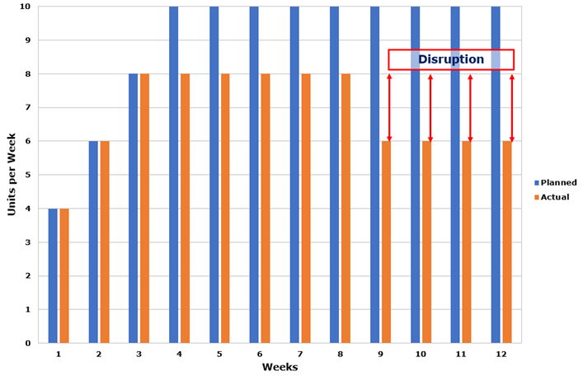
The Measured Mile
Uninterrupted Work
The “measured mile” takes into account actual site conditions.
Compares a section of uninterrupted work with a section of interrupted work of the same nature.
It is based upon actual outputs at the project.
It is not a theoretical calculation or study.

Slide 18
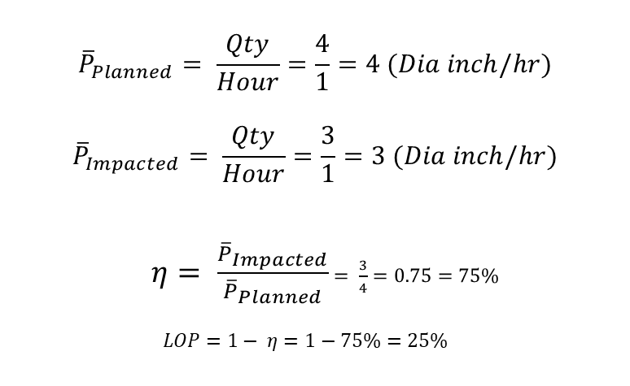
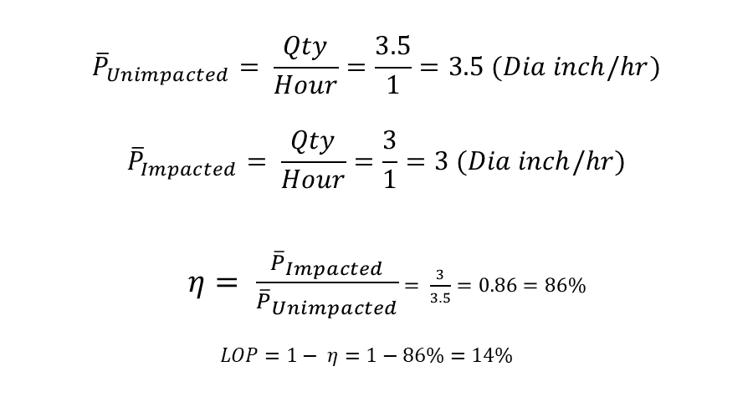
The Measured Mile
Compared with other methodologies:
Total Cost Methodology
Measured Mile Methodology
$${\overline{P}}_{Planned}= \frac{Qty}{Hour}=\frac{4}{1}=4 (Dia inch/hr)$$
$${\overline{P}}_{Impacted}= \frac{Qty}{Hour}=\frac{3}{1}=3 (Dia inch/hr)$$
  $η= \frac{{\overline{P}}_{Impacted}}{{\overline{P}}_{Planned}}$ $= \frac{3}{4}=0.75=75\%$
  $$LOP=1− η=1−75\%=25\%$$
$${\overline{P}}_{Unimpacted}= \frac{Qty}{Hour}=\frac{3.5}{1}=3.5 (Dia inch/hr)$$
$${\overline{P}}_{Impacted}= \frac{Qty}{Hour}=\frac{3}{1}=3 (Dia inch/hr)$$
  $η= \frac{{\overline{P}}_{Impacted}}{{\overline{P}}_{Unimpacted}}$ $= \frac{3}{3.5}=0.86=86\%$
  $$LOP=1− η=1−86\%=14\%$$

Slide 19
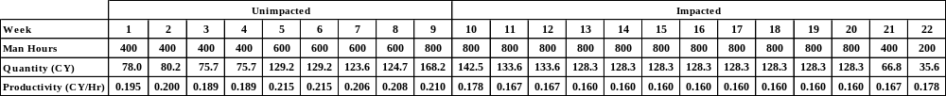
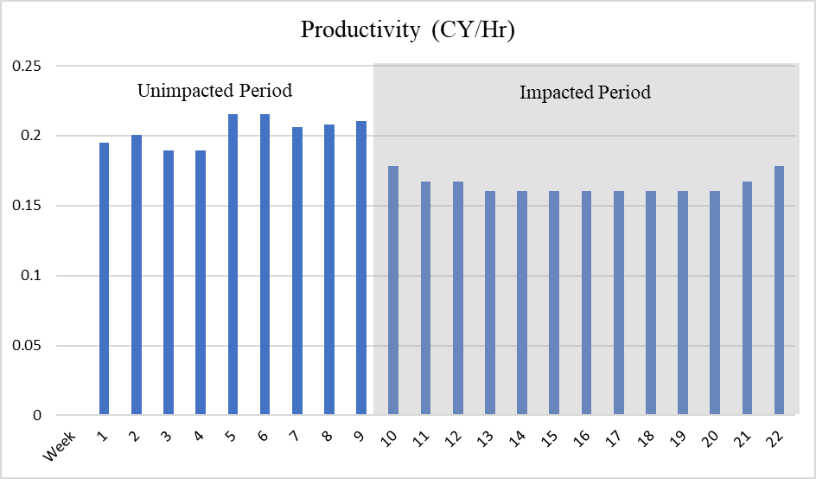
The Measured Mile – Application Example:
Case Study Sample – Concrete Placement:

Slide 20
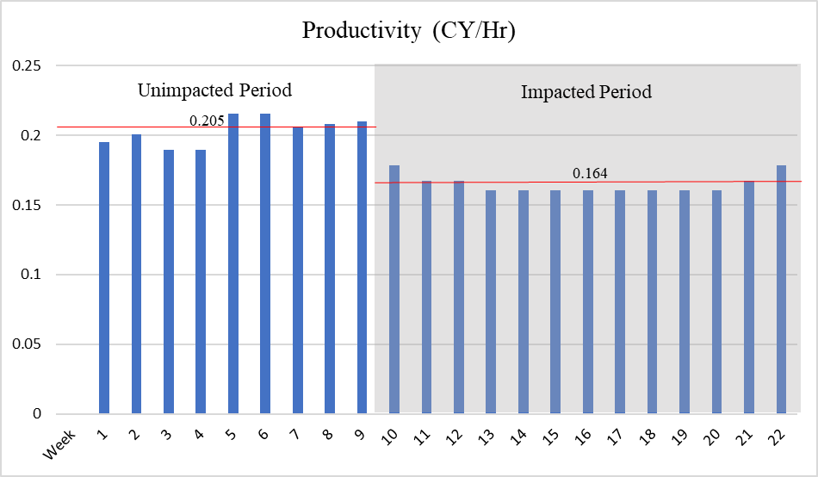
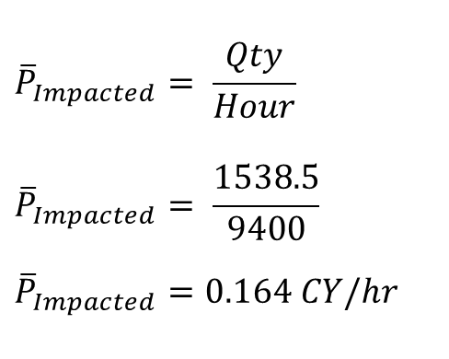
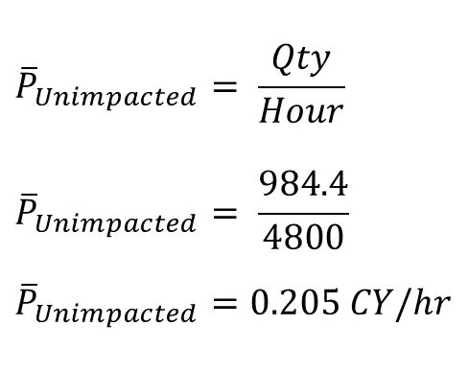
The Measured Mile – Application Example:
Case Study Sample – Concrete Placement:
$${\overline{P}}_{Unimpacted}= \frac{Qty}{Hour}$$
$${\overline{P}}_{Unimpacted}= \frac{984.4}{4800}$$
$${\overline{P}}_{Unimpacted}=0.205 CY/hr$$
$${\overline{P}}_{Impacted}= \frac{Qty}{Hour}$$
$${\overline{P}}_{Impacted}= \frac{1538.5}{9400}$$
$${\overline{P}}_{Impacted}=0.164 CY/hr$$

Slide 21
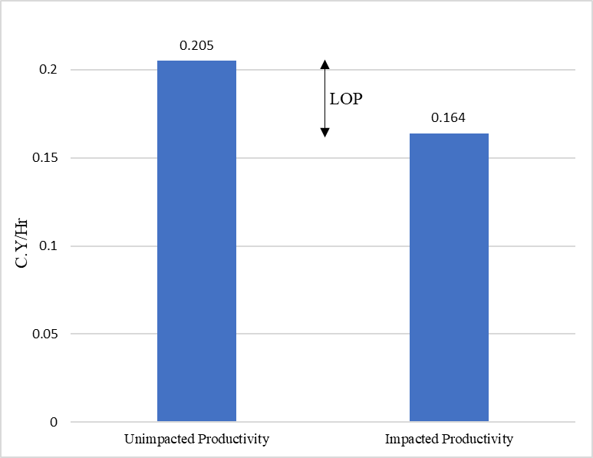
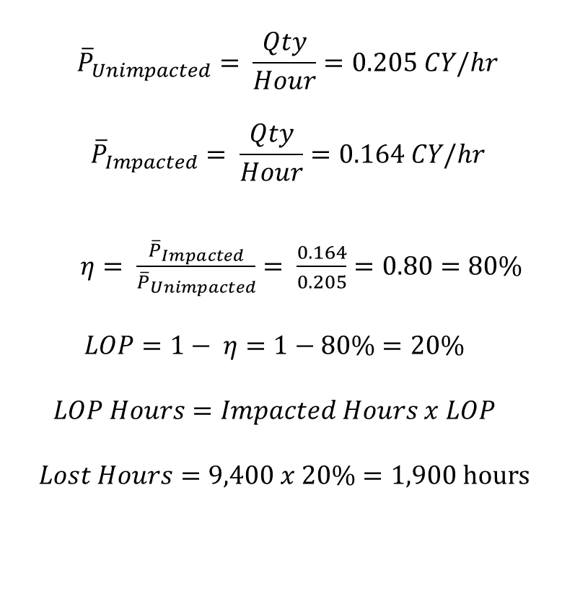
The Measured Mile – Application Example:
Case Study Sample – Concrete Placement:
$${\overline{P}}_{Unimpacted}= \frac{Qty}{Hour}=0.205 CY/hr$$
$${\overline{P}}_{Impacted}= \frac{Qty}{Hour}=0.164 CY/hr$$
  $η= \frac{{\overline{P}}_{Impacted}}{{\overline{P}}_{Unimpacted}}$ $= \frac{0.164}{0.205}=0.80=80\%$
  $$LOP=1− η=1−80\%=20\%$$
  $$LOP Hours=Impacted Hours x LOP$$
  $$Lost Hours=9,400 x 20\%=1,900 hours$$

Slide 22
The Measured Mile
Sample Issues with implementation
Requires an impact free period of the Project – which may not exist.
Data used must be free of errors – verification of data is recommended.
Contractual route may dictate the reliability of data used:
  Unit Rates.
  Lump Sum – Payment Requests – Relationship with quantities.
Comparability work – scope – conditions – labour.
Causal link – don’t assume all inefficiencies in impacted period are relevant.

Slide 23
Expert’s Views on Productivity Claims
Contract Language and Productivity.
Contract/Procurement Route and Productivity.
Recording Progress and Records.
The Measured Mile.
Summary.

Slide 24
Expert’s Views on Productivity Claims
Contract Language and Productivity.
Contract/Procurement Route and Productivity.
Recording Progress and Records.
The Measured Mile.
Summary.
Summary

Slide 25
Summary Points:
Read the Contract – does the Contract preclude Productivity claims?
Ensure ongoing monitoring on productivity against a benchmark – recognize issues early – don’t wait until Project closeout.
Measured Mile is the preferred method of productivity analysis – if implemented correctly.
Ensure Measured Mile takes account for productivity impacts that are not recoverable (Weather in the North of Brazil is a good example).
Whether the actual unimpacted performance is better or worse than planned is irrelevant.
Ensure the data used for a Measured Mile Analysis is free from errors – cross check data provided with source data.

Slide 26

Simon Braithwaite
New York, USA – Manchester, UK
Obrigado!

