Slide 1
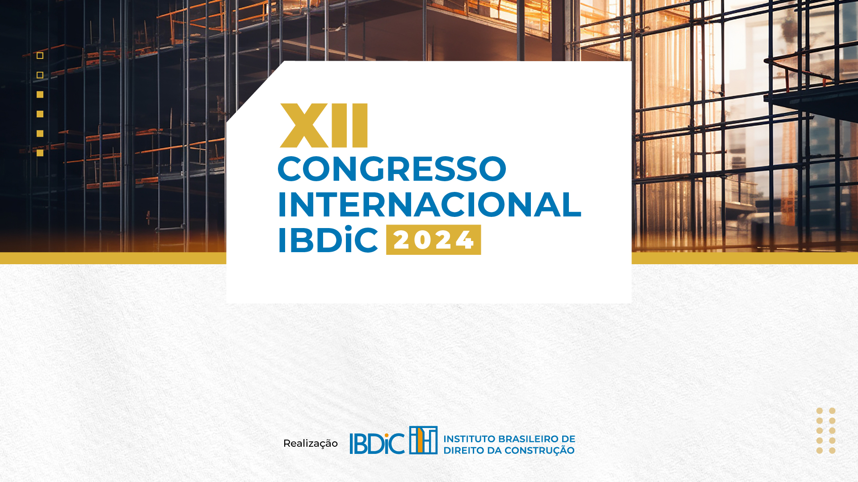
Laura Miller – Senior Managing Director
Measuring Loss of Productivity in Construction, Assets and Projects
Sao Paulo, Brazil – 29 August 2024

Slide 2


Hello, I am
Laura Miller
FTI Consulting - Senior Managing Director
Construction, Projects and Assets
Pittsburgh, Pennsylvania - USA
CPA, CFE and CCA expert in the calculation of construction delay and disruption related damages. Ms. Miller has testified in depositions, at trial, AAA and ICDR arbitrations. Ms. Miller’s expertise includes the analysis of construction damages relating to the impact of design changes, change orders, delays, productivity, inefficiencies, and accelerations. She has 30 years of construction industry related experience and has been consecutively recognized as a Who’s Who Legal construction expert 2016-2024.

Slide 3

Most Common Productivity Analyses
Measured Mile
  - Most Preferred
  - Accounts for Contractor Inefficiency
  - Eliminates Need for Reliance on Bid Reasonableness
  - Based on Actual Achieved Data
  - Can be modified to fit available data
MCAA
  - Sometimes used in mediation
  - More often used as back-check to MM
  - Can be utilized as primary claim IF documentation challenges preclude MM
  - Must have awareness of limitations and applicability – incorrect use can disqualify

Slide 4
MCAA
Credibility for
Sanity Check
Change Orders, Productivity &
Overtime – Ed. 2016
Purpose: a planning tool not intended to be a
source to calculate absolute productivity percentages or costs.
Step 1
Step 2
Step 3
Sanity Check
Hours Overrun
Discrete Impacts
Identify & Remove
Measured Mile
MCAA
Inefficiency Calcs
Delay with NTP
Design Changes
Workers Strike

Slide 5
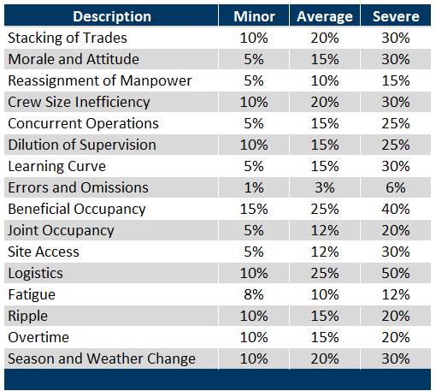
MCAA
Change Orders, Productivity & Overtime
Edition 2016
MCAA - Inefficiency Factors

Slide 6

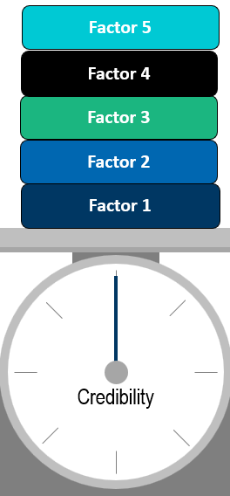
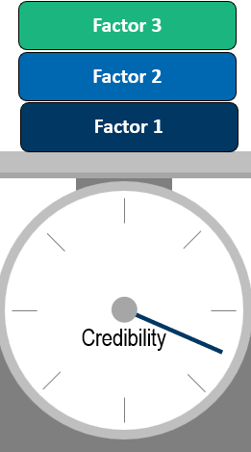
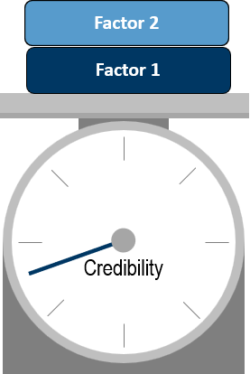
Credibility
Limit Use of Factors to Increase
Reasonableness (≤ 3 factors)

Slide 7
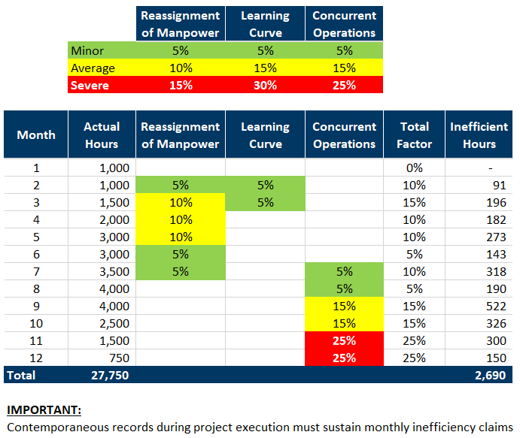
Example: 3 Factor Application

Slide 8


MCAA Example/Case Studies

Slide 9
MCAA in Conjunction with Measured Mile
Full calculation of productivity impact based on Measured Mile
  - Lost Hours = 10,000 hours x $50/hour = $500,000 loss
  - 10,000 “lost” hours INCLUDED in 50,000 actual total hours spent
  - % Inefficiency = 20%
Compare MM Calculated % inefficiency to total from MCAA factors
Does MCAA view affirm reasonableness of MM calculation?
Description |  | Average | Severe
Reassignment of Manpower |  | 10%
Concurrent Operations |  |  | 25%
Errors and Omissions |  |  | 6%
Inefficiency Factor |  | 10% | 31%
Timeframe | Total Actual Hours | Average Impact | Severe Impact | Total Ineff. Hours
Month 1 | 10,000 |  |  | -
Month 2 | 10,000 | 909 | 2,366 | 3,276
Month 3 | 10,000 | 909 | 2,366 | 3,276
Month 4 | 10,000 | 909 | 2,366 | 3,276
Month 5 | 10,000 | 909 |  | 909
Total | 50,000 | 3,636 | 7,099 | 10,736
 |  | % Inefficiency |  | 21%

Slide 10
Case 1 - Large Bridge Construction
Used for purposes of mediation
Prior to deep expert involvement
Impacts described by contractor – contractor felt strong argument on severe impacts
Used MCAA factors to estimate loss from impacts

Slide 11
Case 2 - Louisiana Paper Facility
Contractor’s expert relied on MCAA to assert lost productivity costs
Contractor’s expert overlooked key guidance and misapplied factors
  - Overlooked caution to apply factors on T&M scopes
  - Ultimately applied the same productivity factor to total hours
Provided opportunity for owner, via our response, to argue MCAA-based calculation should not be considered

Slide 12

Q & A

Slide 13


Laura Miller
Senior Managing Director, Forensics & Litigation Consulting
+1 412 227 3864
laura.miller@fticonsulting.com
Laura Miller is an expert in the calculation of construction delay and disruption related damages. Ms. Miller has nearly 30 years of construction and damages related experience. She has performed contemporaneous construction cost reviews and has analyzed the financial impact of various construction cost, schedule, and contract issues, both in private and public contracts. Ms. Miller has testified in depositions, at trial, and in AAA, ICDR, and DRB arbitrations. Her expertise includes the analysis of construction damages considering the impact of design changes, change orders, delays, disruptions, inefficiencies, and accelerations. Her work in the construction arena has also involved issues such as terminations, defaults, limitations under Federal Acquisition Regulations, and integration of damages with schedule delay.
Ms. Miller’s experience encompasses various industry sectors, including projects in the oil and gas, power, industrial, transportation, commercial building, pipeline, and government contracting sectors. She has consulted to steel companies, electric and water utilities, oil and gas companies, construction companies, housing authorities, insurance companies, sureties, equipment producers, school districts, municipalities and other government entities. A recognized expert in the area of construction damages, Ms. Miller has testified in various ADR and trial proceedings, and she has presented her findings at several mediations.
Ms. Miller has presented to local and national organizations on topics related to the tracking and verification of construction costs, the quantification of construction damages, and construction fraud.
Awards & Recognition
Who’s Who Legal: Construction, Law Business Research, (2016-2023)
Who’s Who Legal: Consulting Experts – Quantum & Delay, Law Business Research, (2016-2023)
Education
B.S., Business Administration and Accounting, John Carroll University
M.B.A., University of Pittsburgh, Joseph M. Katz Graduate School of Business
Certifications
Certified Public Accountant (CPA), Commonwealth of Pennsylvania
Certified Fraud Examiner (CFE)
Certified Construction Auditor (CCA)

